Slide 1
Database Connectivity in Python
Unit 2

Slide 2
Introduction
MySQL is one of the most popular database management systems (DBMSs) on the market today. It ranked second only to the Oracle DBMS in this year’s DB-Engines Ranking. As most software applications need to interact with data in some form, programming languages like Python provide tools for storing and accessing these data sources.
SQL stands for Structured Query Language and is a widely used programming language for managing relational databases.
There is a free MySQL Community Edition available from the official MySQL website. You can download and install it on your local PC from: http://dev.mysql.com/downloads/
https://www.youtube.com/watch?v=GIRcpjg-3Eg – How to install mysql

Slide 3
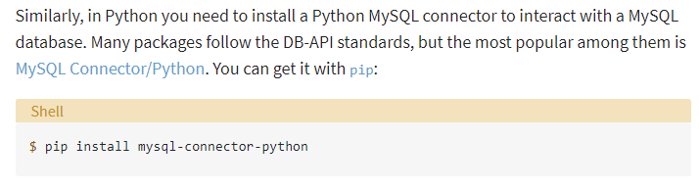
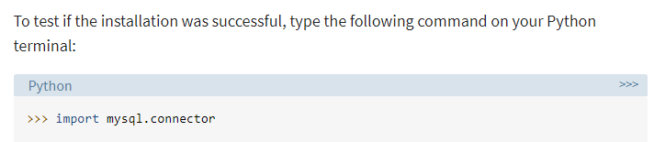
Installing MySQL Connector/Python
A database driver is a piece of software that allows an application to connect and interact with a database system. Programming languages like Python need a special driver before they can speak to a database from a specific vendor.

Slide 4
Establish connection with MySQL
import mysql.connector as mysql
conn = mysql.connect(user='root', password='scott',host='127.0.0.1')
print(conn)
conn.close()

Slide 5
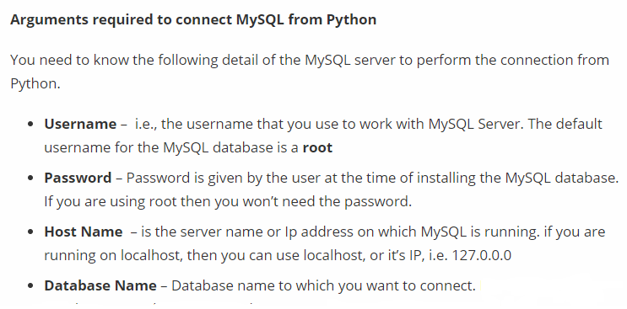

Slide 6
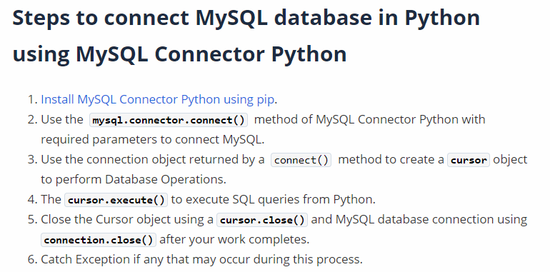

Slide 7
Creating database
import mysql.connector as mysql
conn = mysql.connect(user=‘root’, password=‘scott’, host='127.0.0.1')
c=conn.cursor()
c.execute("CREATE DATABASE python")
conn.close()

Slide 8
Display all available databases using fetchall()
import mysql.connector as mysql
conn = mysql.connect(user=‘root’, password=‘scott’, host='127.0.0.1')
c=conn.cursor()
c.execute("SHOW DATABASES")
print(c.fetchall())
conn.close()

Slide 9
Display all available databases using for loop
import mysql.connector as mysql
conn = mysql.connect(user=‘root’, password=‘scott’, host='127.0.0.1')
c=conn.cursor()
c.execute("SHOW DATABASES")
For i in c:
print(i)
conn.close()

Slide 10
Use database
import mysql.connector as mysql
conn = mysql.connect(user=‘root’, password=‘scott’,host='127.0.0.1')
c=conn.cursor()
c.execute("SHOW DATABASES")
print(c.fetchall())
c.execute("USE python")
conn.close()

Slide 11
OR

Slide 12
Directly providing database name in connect
import mysql.connector as mysql
conn = mysql.connect(user=’root’, password=‘scott’,host='127.0.0.1’, database=‘python’)
conn.close()

Slide 13
To check if any table exist in the database
import mysql.connector as mysql
conn = mysql.connect(user=‘root’, password=‘scott’,host='127.0.0.1')
c=conn.cursor()
c.execute(“use fycs_ab”)
c.execute("show tables")
print(c.fetchall())
conn.close()

Slide 14
Creating a table
import mysql.connector as mysql
conn = mysql.connect(user=‘root’, password=‘scott’,host='127.0.0.1')
c=conn.cursor()
c.execute("USE python")
c.execute("create table employee(eno int(5),ename varchar(20))")
conn.close()
Primary Key
When creating a table, you should also create a column with a unique key for each record.
This can be done by defining a PRIMARY KEY.

Slide 15
Alter table command
If the table already exists, use the ALTER TABLE keyword
To add a column:-ALTER TABLE tablename ADD COLUMN columnname datatype…
To modify a column:- ALTER TABLE table_name MODIFY COLUMN column_name datatype;

Slide 16
Inserting data and displaying it
import mysql.connector as mysql
conn = mysql.connect(user=‘root’, password=‘scott’,host='127.0.0.1')
c=conn.cursor()
c.execute("use python")
c.execute("insert into employee values(1,'abc’)”)
conn.commit()
c.execute("select * from employee")
print(c.fetchall())
conn.close()

Slide 17
Example
Create a database with your name.
Create a table student with columns rollno, name, dob, marks
Insert 3 records
Display the records
Change the name of the student having roll no 4 to ‘Riya Gupta’.
Make the column rollno as primary key.
Add a new column grade with character 2

Slide 18
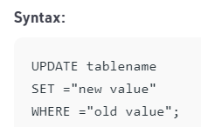
Updating the table
The update is used to change the existing values in a database. By using update a specific value can be corrected or updated

Slide 19
import mysql.connector as mysql
conn = mysql.connect(user="root", password="scott",host='127.0.0.1')
c=conn.cursor()
c.execute("use python")
c.execute("select * from employee")
rows = c.fetchall()
c.execute("update employee set ename = ‘steve' where eno = 1")
conn.commit()
c.execute("select * from employee")
print(c.fetchall())
conn.close()

Slide 20
import mysql.connector as mysql
conn = mysql.connect(user="root", password="scott",host='127.0.0.1')
c=conn.cursor()
c.execute("use python")
c.execute("select * from employee")
rows = c.fetchall()
empid = rows[1][0]
print(empid)
c.execute("update employee set ename = 'stu' where eno = "+str(empid))
conn.commit()
c.execute("select * from employee")
print(c.fetchall())
conn.close()

Slide 21
Deleting records
You can delete records from an existing table by using the "DELETE FROM" statement:
import mysql.connector as mysql
conn = mysql.connect(user="root", password="scott",host='127.0.0.1')
c=conn.cursor()
c.execute("use python")
c.execute("select * from employee")
rows = c.fetchall()
c.execute(“delete from employee where eno=1")
conn.commit()
print(mycursor.rowcount, "record(s) deleted")
conn.close()

Slide 22
cursor.rowcount
This read-only property returns the number of rows returned for SELECT statements,
or the number of rows affected by DML statements such as INSERT or UPDATE.

Slide 23
Reading single & multiple results of query execution- SELECT statement
All the data:- select * from tablename;
Selected columns all rows:- select column1, column2 from tablename;
Selected rows all columns:- select * from tablename where condition;
Selected rows selected columns:- select column1, column2 from tablename where condition

Slide 24
Sorting – asc/desc
Select * from cust order by savings desc;
By default sorting done in ascending order.

Slide 25
Pattern matching(LIKE operator)
Wildcard %(more than one character) or _(exactly one character)
A% - starting from A
%A- ending at A
Raj---→ _a% - second character a
_ _a%
%a%- name contains ‘a’

Slide 26
Deleting a table
import mysql.connector as mysql
conn = mysql.connect(user="root", password="scott",host='127.0.0.1')
c=conn.cursor()
c.execute("use python")
c.execute("Drop table employee")
conn.close()

Slide 27
Deleting a database
import mysql.connector as mysql
conn = mysql.connect(user="root", password="scott",host='127.0.0.1')
c=conn.cursor()
c.execute("Drop database python")
conn.close()

Slide 28
Queries for student table
Display name and marks of student with rollno 3.
Delete the records of the student with name ‘priti’.
Display all the records where marks are greater than 20

Slide 29
Practical 2(a)
Create a table Bike containing the following columns:- Bikeid integer primary key, Bikename, bikecost, prdt(purchase date).
Insert 2 records
Display the structure of the table.
Add a new column sldt(sale date)
Change the content of the column bikecost to 80,000 for bikeid 1
Delete the row for bikename ‘Honda’
Delete the table

Slide 30
Practical 2(b)- Use EMP table
Display the details of all employees who are earning salary greater than 1000.
List the employees in ascending order of their salary.
List the employees whose name have character set ‘ll’ together.
Display the details of all employees who are working as ‘Manager’
List all the clerks of department 20.

Slide 31
Executing transactions
The database transaction represents a single unit of work. Any operation which modifies the state of the MySQL database is a transaction.
For example, take an example of Bank amount transfer Transaction, it involves two major transactions.
Withdrawal of money from account A
Deposit Money to Account B
If the first Transaction is executed successfully, but second failed, in this case, we need to re-deposit money back to account A. To manage such cases we need transaction management.
Using ACID properties, we can study transaction management well. ACID stands for Atomicity, Consistency, Isolation, and Durability.

Slide 32
Python MySQL Commit(), rollback() and setAutoCommit() to manage transactions
To manage MySQL transactions in python follow these steps: –
Create MySQL database connections in python.
Prepare the SQL queries that you want to run as a part of a transaction. For example for bank transfer, we can combine two SQL queries(withdrawal money and deposit money query) in a single transaction.
Set an auto-commit property of MySQL connection to false.
Execute all queries one by one using cursor.execute()
If all queries execute successfully commit the changes to the database
If one of the queries failed to execute rollback all the changes.
Catch any SQL exceptions that may occur during this process
Close the cursor object and MySQL database connection

Slide 33
Python MySQL Connector provides the following method to manage database transactions.
commit – MySQLConnection.commit() method sends a COMMIT statement to the MySQL server, committing the current transaction.
rollback – MySQLConnection.rollback() revert the changes made by the current transaction.
autocommit – MySQLConnection.autocommit() value can be assigned as True or False to enable or disable the auto-commit feature of MySQL. By default its value is False.

Slide 34
MySQL
Create database bank;
Use bank;
Create table account_A(id int primary key,balance int);
Similarly create account_B
Insert 2 records in both tables.

Slide 35
import mysql.connector
from mysql.connector import Error
from mysql.connector import errorcode
try:
conn = mysql.connector.connect(host='localhost', database=‘bank', user=‘root’, password=‘scott')
conn.autocommit = false
cursor = conn.cursor()
# withdraw from account A
cursor.execute(“Update account_A set balance = balance-500 where id = 1”)
# Deposit to account B
cursor.execute(“Update account_B set balance = balance+500 where id = 2”)
print ("Record Updated successfully ")
#Commit your changes
conn.commit()

Slide 36
except mysql.connector.Error as error :
print("Failed to update record to database rollback: {}".format(error))
#reverting changes because of exception
conn.rollback()
finally:
#closing database connection.
if(conn.is_connected()):
cursor.close()
conn.close()
print("connection is closed")

Slide 37
Understanding exceptions in database connectivity
There are two levels of error message severity in MySQL.
Error
Warning
An Error indicates a problem with query or command which prevented it from being executed.
Warning tells you some thing unexpected has happened that could cause problem down the line, but it is not severe enough to stop the statement from being executed.

Slide 38
Error codes
Errors and warnings in MySQL contains three pieces of information:
There are hundreds of MySQL-specific error codes. Fortunately, you don't need to memorize them as the mysql.connector.errorcode module contains all the MySQL-specific error codes.
from mysql.connector import errorcode

Slide 39
Exceptions Classes
All the exception classes for dealing with error and warnings are defined in mysql.connector.errors module.
The mysql.connector.errors.Error is the base class for all the other exceptions. We can use it to catch any kind of exception.

